Slide 1

Building Gateway Services
Graham Robinson
John Patterson
• 4th September 2017

Slide 2
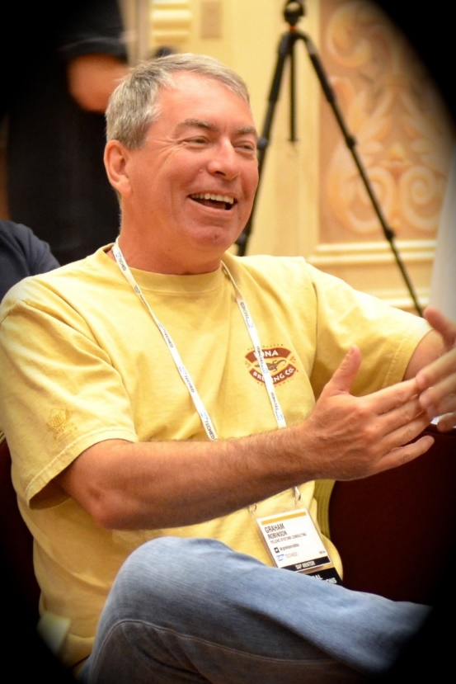


Introduction
@grahamrobbo
@jasper_07

Slide 3
Agenda
Some Warnings
CDS
Service Design
Code patterns for reusability

Slide 4
Agenda
Some Warnings
CDS
Service Design
Code patterns for reusability

Slide 5
Warning – This is not For Beginners

Slide 6
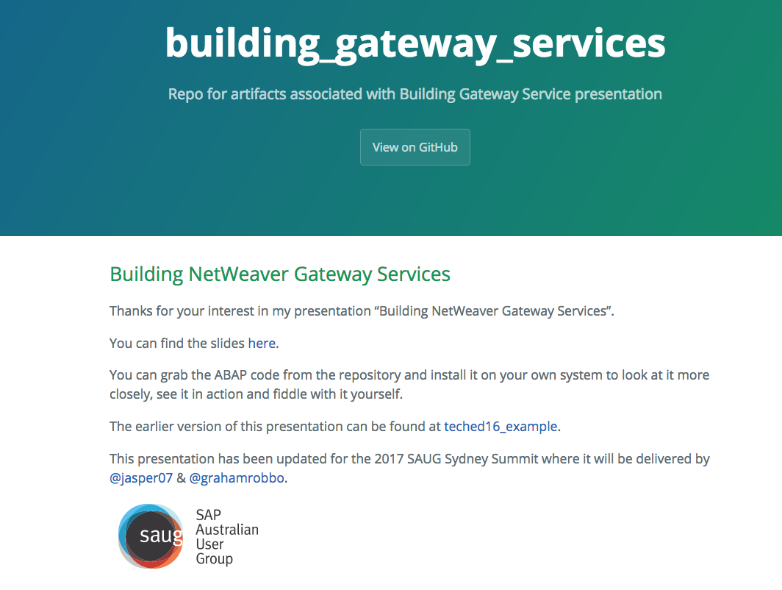
Warning - Homework
https://grahamrobbo.github.io/building_gateway_services/
To install you will also need abapGit
https://abapGit.org

Slide 7
Warning – focus on consumption

Slide 8
Warning – we do not have all the answers

Slide 9
Agenda
Some Warnings
CDS
Service Design
Code patterns for reusability

Slide 10
@jasper_07 to put brilliant slides in here!

Slide 11
Agenda
Some Warnings
CDS
Service Design
Code patterns for reusability

Slide 12
Service Design Principles
Design for Consumers
Think oData i.e. Entities, Associations, etc.
Leave SAP domain knowledge at the door
REST API’s should be self-describing
Function Imports should be for special cases

Slide 13
General Theory of API Design

Slide 14
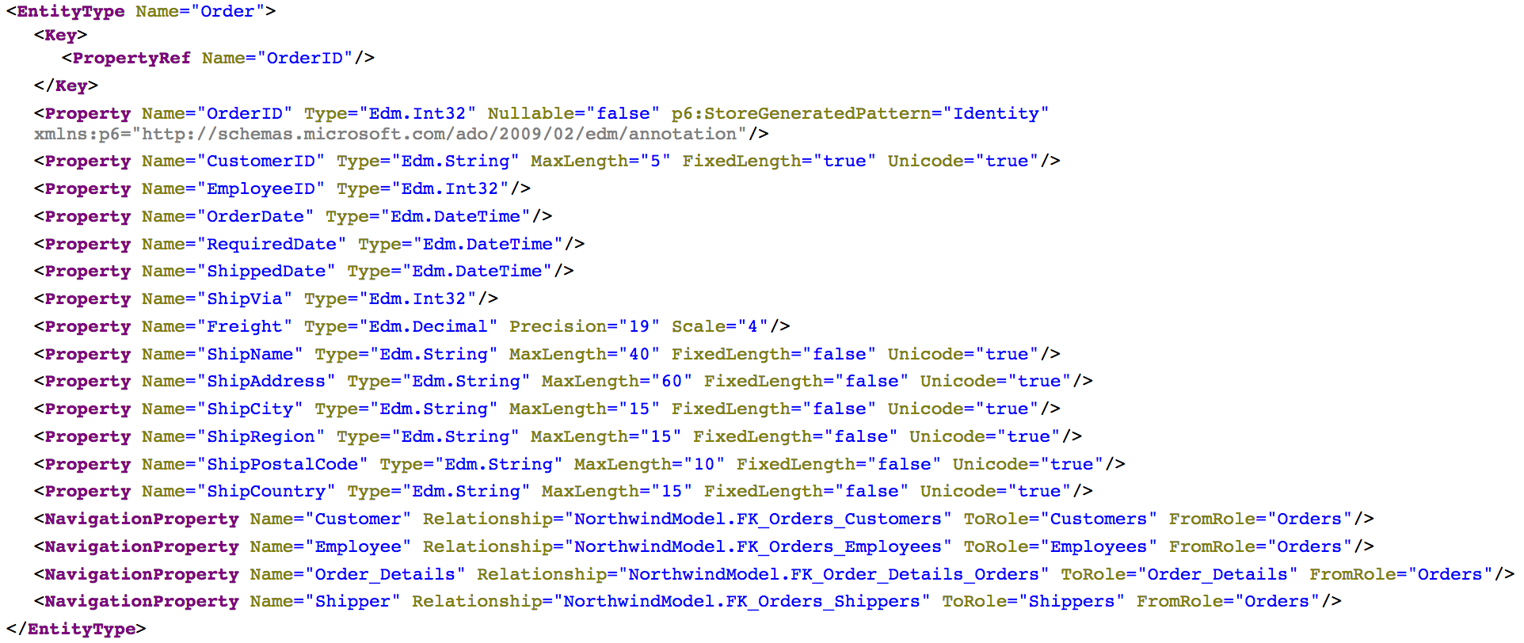
Consumer View of API
Source: http://services.odata.org/northwind/northwind.svc/$metadata

Slide 15
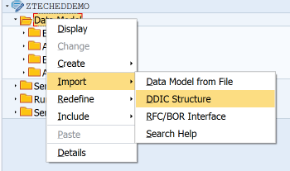
Bind Entity to DDIC Structure

Slide 16
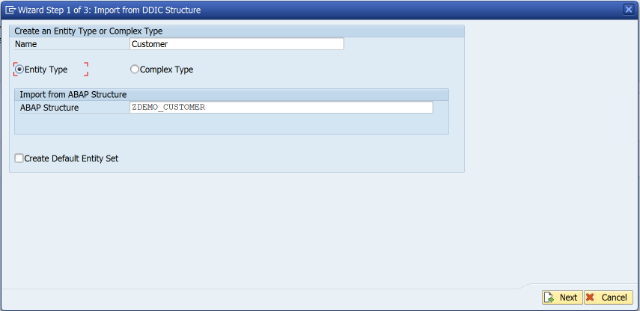
Bind Entity to DDIC Structure

Slide 17
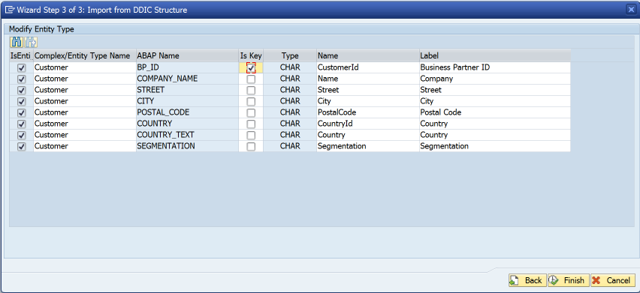
Bind Entity to DDIC Structure

Slide 18
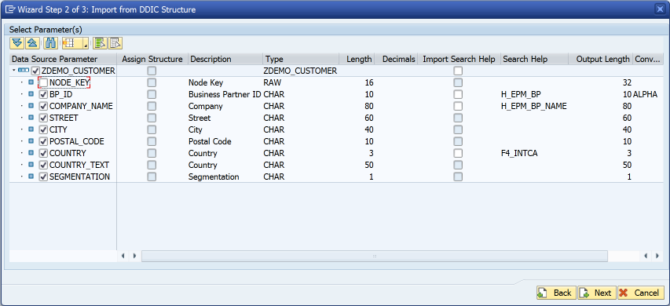
Bind Entity to DDIC Structure

Slide 19
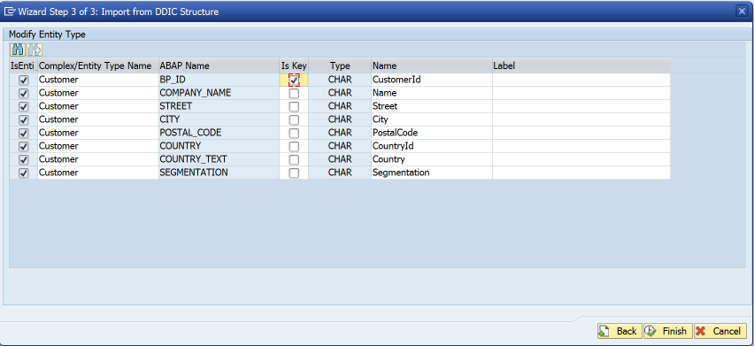
Bind Entity to DDIC Structure
Remove label suggestions
This means labels are determined at runtime rather than design-time

Slide 20
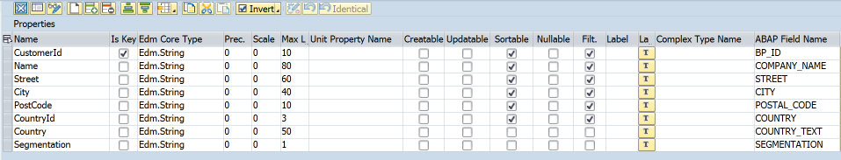
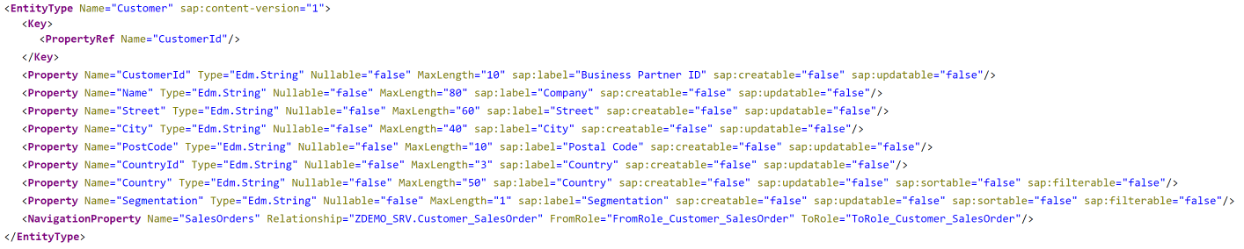
$metadata

Slide 21
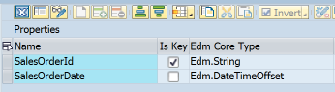
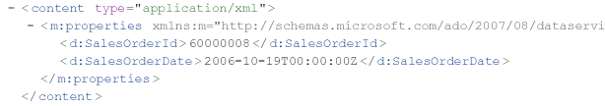
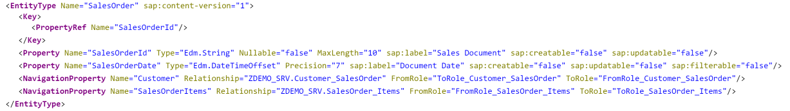
Dates & Times
Use Edm.DateTimeOffset for date/time/timestamp properties
Don’t be tempted to use Edm.String “for convenience”
Edm.DateTime replaced in oData V4 specification

Slide 22
Agenda
Some Warnings
CDS
Service Design
Code patterns for reusability

Slide 23
Code patterns for Reusability
The first rule of reusability is encapsulate all business logic in concrete classes

Slide 24
What a class is not
An ABAP class that only contains static methods is not really a class…..
… in all respects except object type it is a...
Function Group

Slide 25
Code patterns for Reusability
The second rule of reusability ENCAPSULATE ALL BUSINESS LOGIC IN CONCRETE CLASSES

Slide 26
Code patterns for reusability
I like the singleton design pattern in ABAP
Be aware that some people don’t
I don’t care – it works for me
I like getters (& sometimes setters)
Be aware that some people don’t
I don’t care – it works for me
You can implement business logic however you like… just remember the first & second rules of reusability

Slide 27
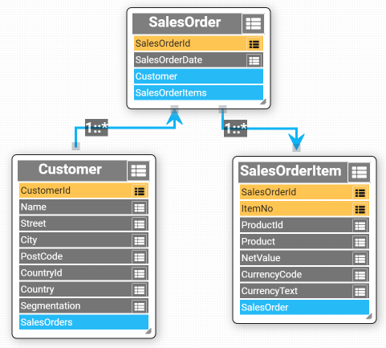
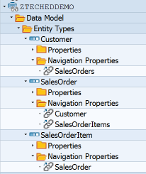
Sample Data Model
Based upon SAP Enterprise Procurement Model

Slide 28
Data Provider Class
DPC
Class

Slide 29
Multiple consumers
DPC
DPC
DPC
Class

Slide 30
Multiple consumers
DPC
DPC
DPC
Common Interface
Class

Slide 31
Replicate GW Method Interface

Slide 32
Avoid Using Deprecated Parameters
https://blogs.sap.com/2017/02/01/avoid-using-deprecated-sap-gateway-apis-in-your-odata-service-implementation/
Nabi Zamani

Slide 33
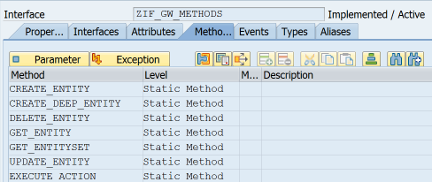
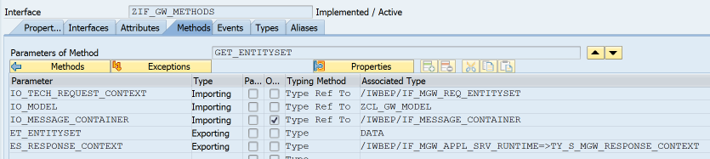
Common Interface
Model
Message Container
Untyped data object

Slide 34
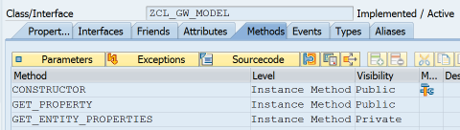
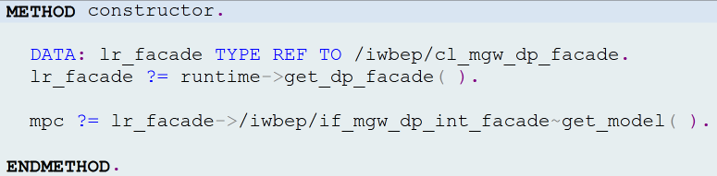
ZCL_GW_MODEL

Slide 35
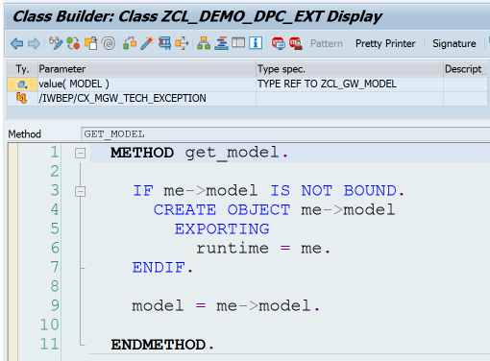
DPC->GET_MODEL

Slide 36
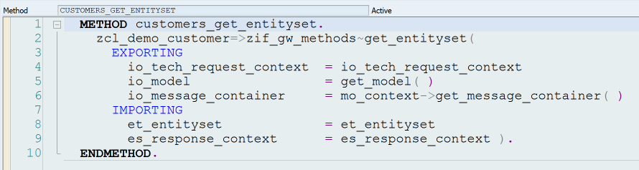
Call BO Class from DPC

Slide 37
oData Operations
 | Identify Primary Key(s) | Instantiate Class | Call class methods | Fill Entity
Create
Read
Update
Delete

Slide 38
GET_ENTITY
Identify primary key(s)
Instantiate BO class
Fill entity

Slide 39
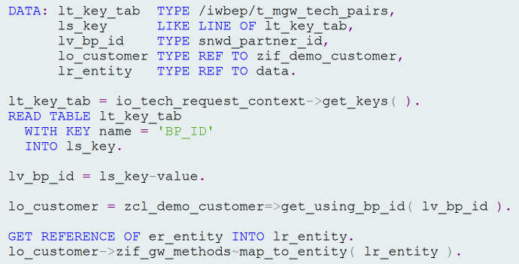
GET_ENTITY V1

Slide 40
GET_ENTITY V1 – Identify Primary Key

Slide 41
GET_ENTITY V1 – Instantiate BO Class

Slide 42
GET_ENTITY V1 – Fill Entity

Slide 43
GET_ENTITY V2

Slide 44
GET_ENTITY V2
lt_key_tab = io_tech_request_context->get_keys( ). READ TABLE lt_key_tab with KEY name = 'BP_ID' into ls_key. lv_bp_id = ls_key-value. lo_customer = zcl_demo_customer=>get_using_bp_id( lv_bp_id ). GET REFERENCE OF er_entity INTO lr_entity. lo_customer->zif_gw_methods~map_to_entity( lr_entity ).

Slide 45
GET_ENTITY V2 – Table Expression
lt_key_tab = io_tech_request_context->get_keys( ). lv_bp_id = lt_key_tab[ name = 'BP_ID' ]-value.
lo_customer = zcl_demo_customer=>get_using_bp_id( lv_bp_id ). GET REFERENCE OF er_entity INTO lr_entity. lo_customer->zif_gw_methods~map_to_entity( lr_entity ).

Slide 46
GET_ENTITY V2 – Conversion Operator
lt_key_tab = io_tech_request_context->get_keys( ).
lo_customer = zcl_demo_customer=>get_using_bp_id( CONV #( lt_key_tab[ name = 'BP_ID' ]-value ) ).
GET REFERENCE OF er_entity INTO lr_entity. lo_customer->zif_gw_methods~map_to_entity( lr_entity ).

Slide 47
GET_ENTITY V2 – Reference Operator
lt_key_tab = io_tech_request_context->get_keys( ).
lo_customer = zcl_demo_customer=>get_using_bp_id( CONV #( lt_key_tab[ name = 'BP_ID' ]-value ) ).
lo_customer->zif_gw_methods~map_to_entity(
REF #( er_entity ) ).

Slide 48
GET_ENTITY V2
lt_key_tab = io_tech_request_context->get_keys( ). lo_customer = zcl_demo_customer=>get_using_bp_id( CONV #( lt_key_tab[ name = 'BP_ID' ]-value ) ). *--------------------------------------------------------* * For update operations we would call class methods here * *--------------------------------------------------------*
lo_customer->zif_gw_methods~map_to_entity(
REF #( er_entity ) ).

Slide 49
GET_ENTITY V2 – Method Chaining
lt_key_tab = io_tech_request_context->get_keys( ). zcl_demo_customer=>get_using_bp_id( CONV #( lt_key_tab[ name = 'BP_ID' ]-value )
)->zif_gw_methods~map_to_entity( REF #( er_entity ) ).

Slide 50
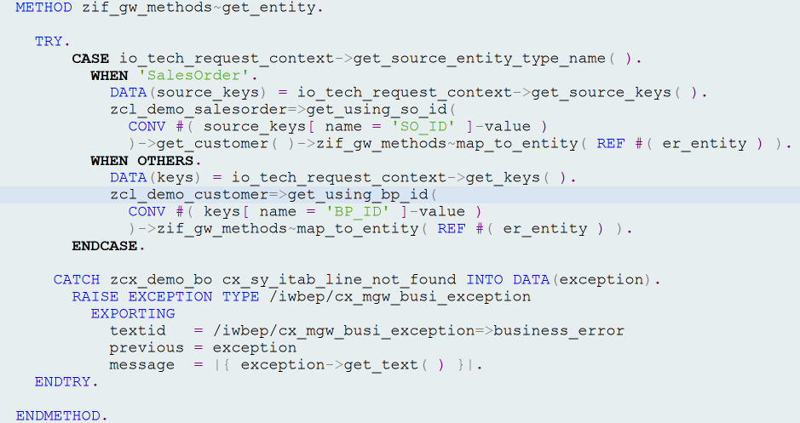
zif_gw_methods~get_entity

Slide 51
zif_gw_methods~get_entity
Use salesorder key to get customer

Slide 52
zif_gw_methods~get_entity
Exception handling

Slide 53
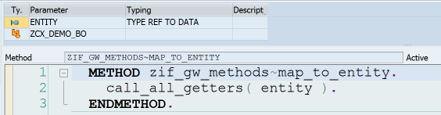
map_to_entity

Slide 54
map_to_entity

Slide 55
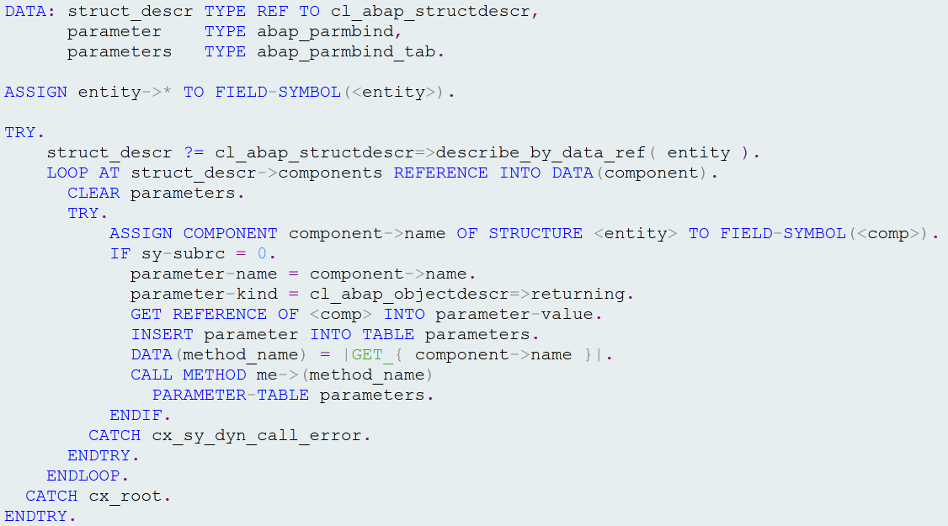
call_all_getters
For each entity component we attempt
to call matching getter functional method
e.g <entity>-prop1 = me->get_prop1( ).

Slide 56
GET_ENTITYSET
Just like GET_ENTITY in a loop…except…

Slide 57
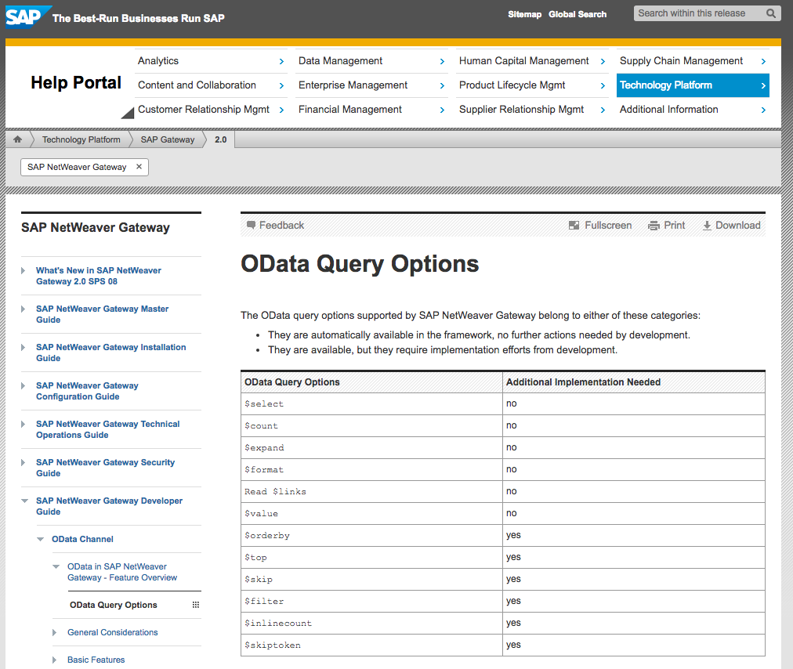
oData Query Options

Slide 58
oData Query Options

Slide 59
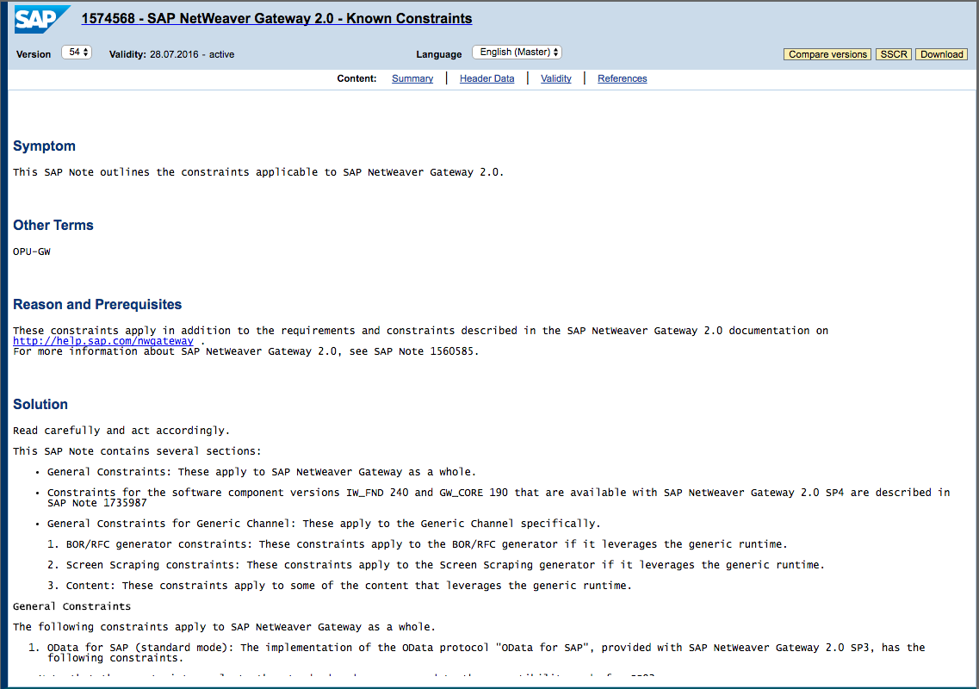
Known Constraints
SAP Note 1574568

Slide 60
zif_gw_methods~get_entityset
Goal is to identify primary key(s) as quickly as possible and use them to fill entities.

Slide 61
zif_gw_methods~get_entityset
Create anonymous data object
$orderby
$filter
$inlinecount
$top & $skip
$count
$skiptoken
Fill entities

Slide 62
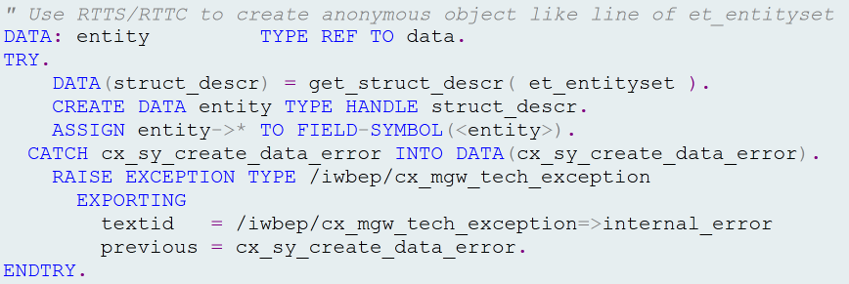
Create Anonymous data Object

Slide 63
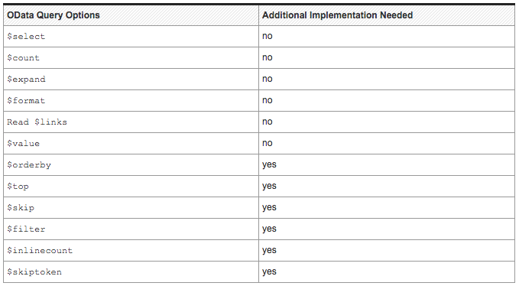
$orderby

Slide 64
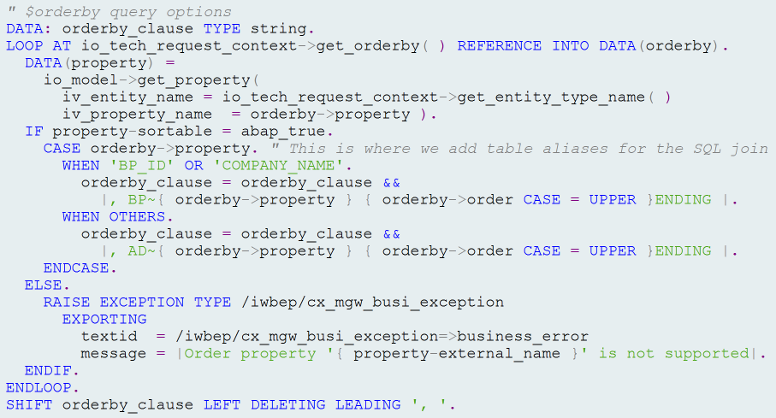
$orderby

Slide 65
$filter

Slide 66
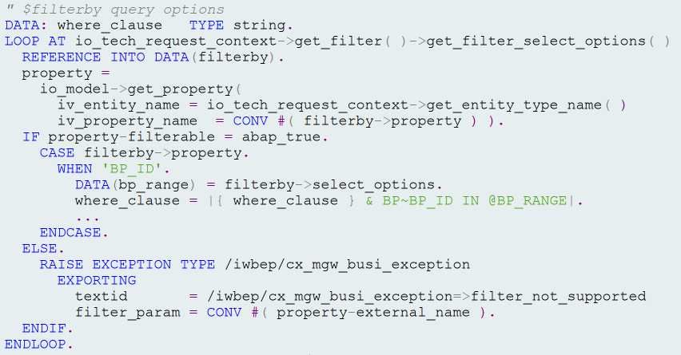
$filter

Slide 67
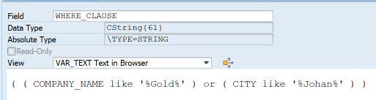
Complex $filter Queries
$filter=substringof(‘Gold’,Name) or substringof(‘Johan’,City)
*Note where_clause may require modification e.g. Table aliases, etc.

Slide 68
$Inlinecount

Slide 69

$inlinecount

Slide 70
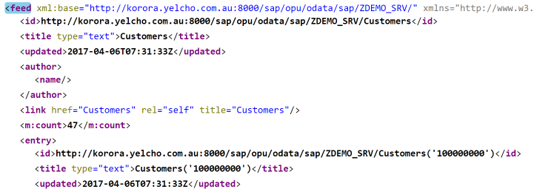
$inlinecount

Slide 71
$top & $skip

Slide 72
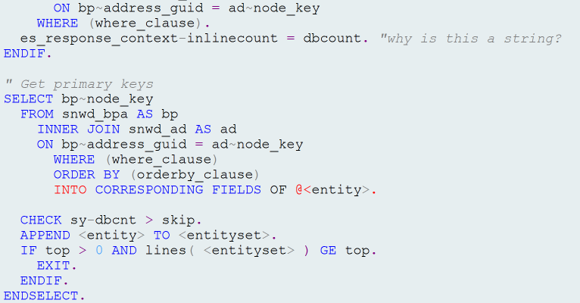
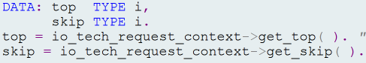

$top & $skip

Slide 73
$count

Slide 74
$count

Slide 75
$skiptoken

Slide 76
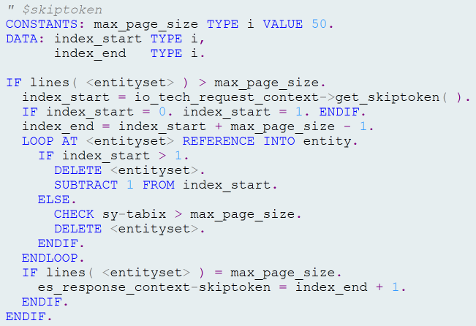
$skiptoken

Slide 77
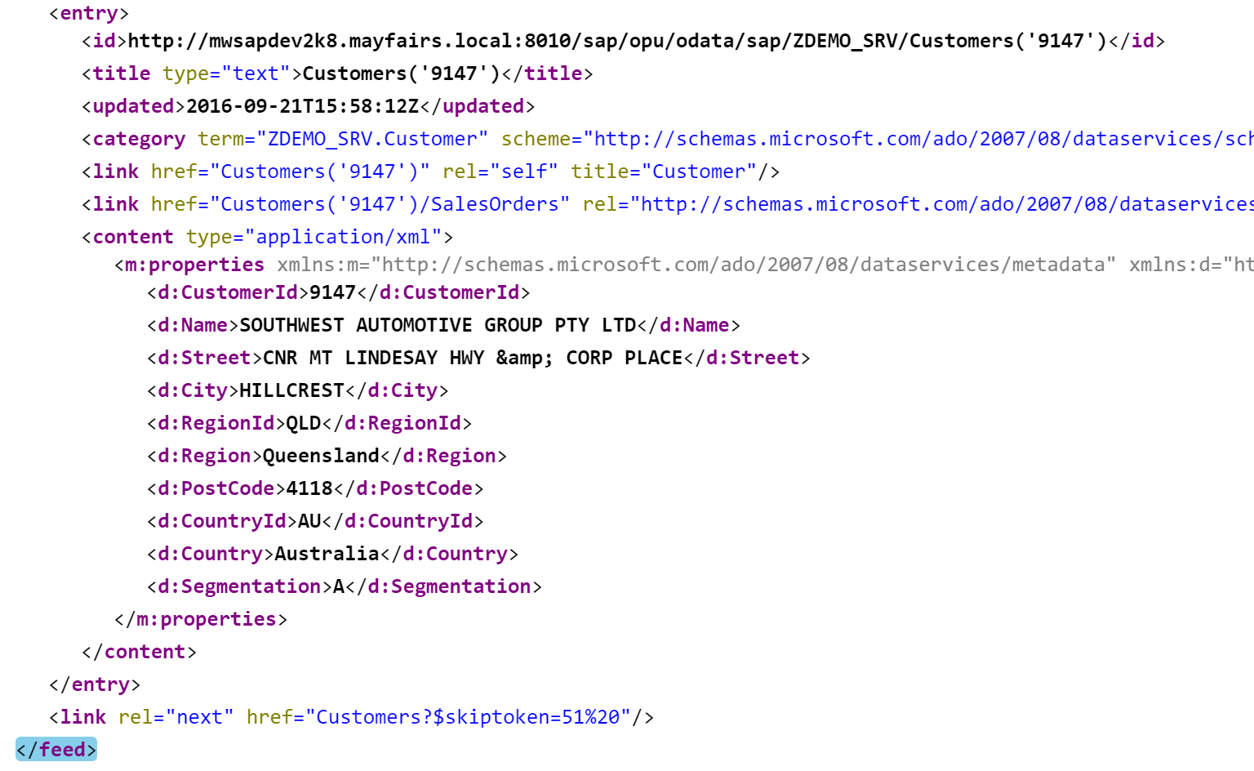
$skiptoken

Slide 78
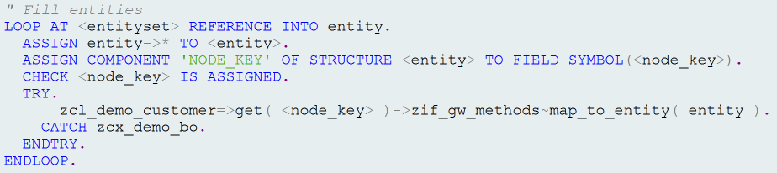
Fill Entities

Slide 79

Where Is the Code?
https://grahamrobbo.github.io/teched16_example/
To install you will also need abapGit
https://abapGit.org

Slide 80
Summary
CDS
Service Design
Design for consumers
Code patterns for reusability
The first & second rule

Slide 81
Where is the code?
https://grahamrobbo.github.io/building_gateway_services/
To install you will also need abapGit
https://abapGit.org

Slide 82
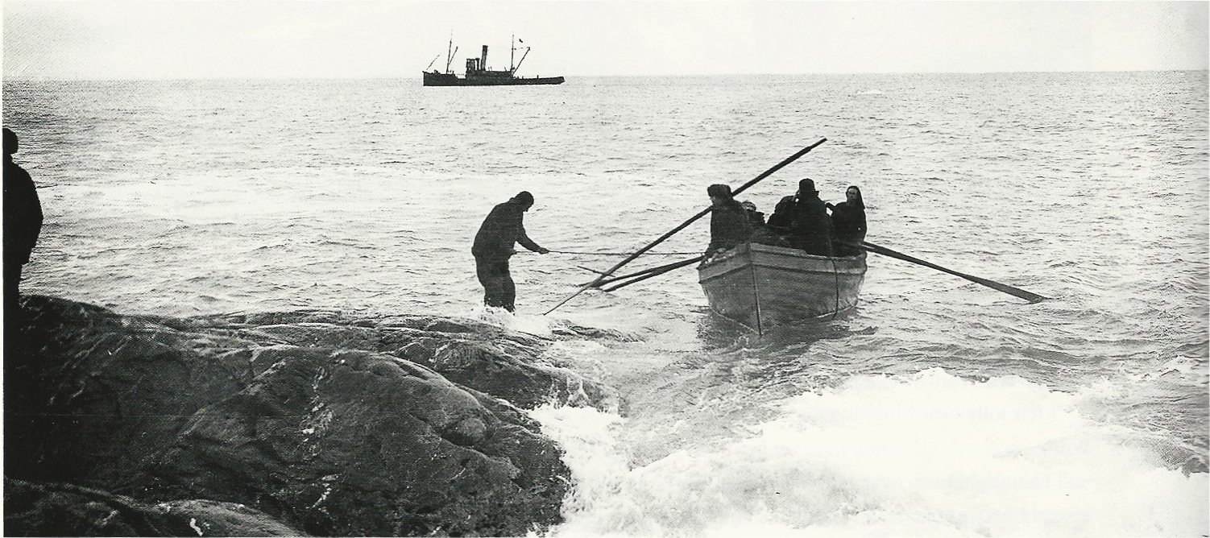

@grahamrobbo
@jasper_07
Photo by Frank Hurley – used with permission

